Slide 1
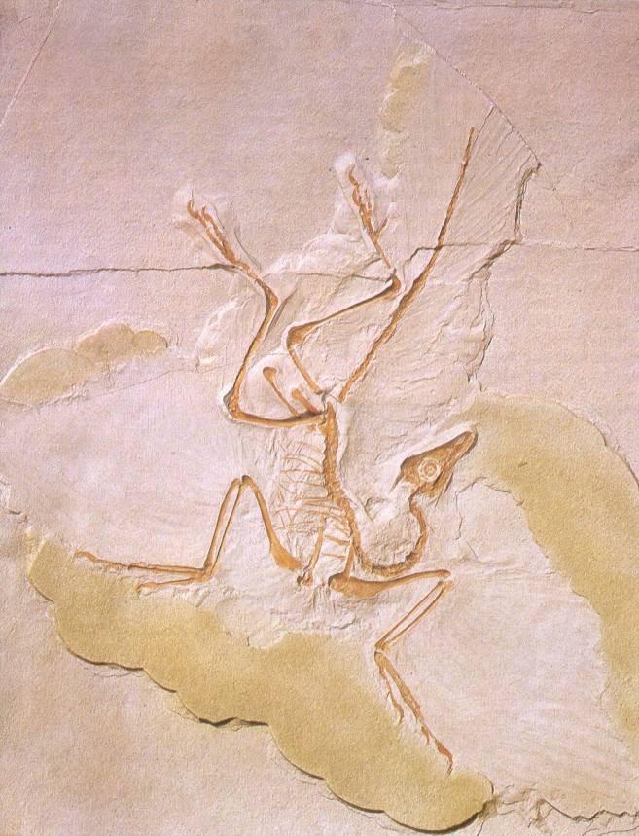
The Fossil Record
Mike Riddle
Institute for Creation Research
www.icr.org
Mike@Train2Equip.com

Slide 2
Topics
The history of life
The fossil record
The fossil record and education
The Cambrian explosion
Famous "transitions" used to support evolution
The mechanism for change
Natural selection
Mutations

Slide 3
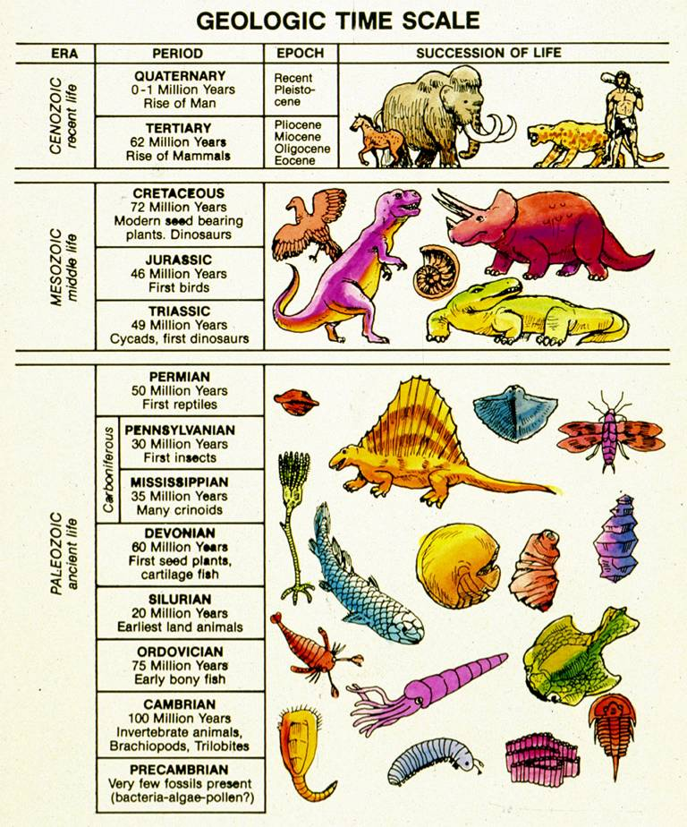
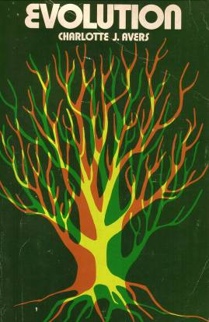
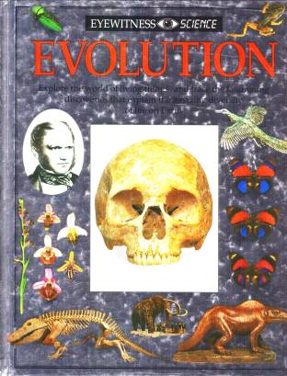
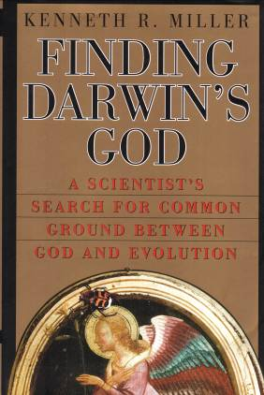
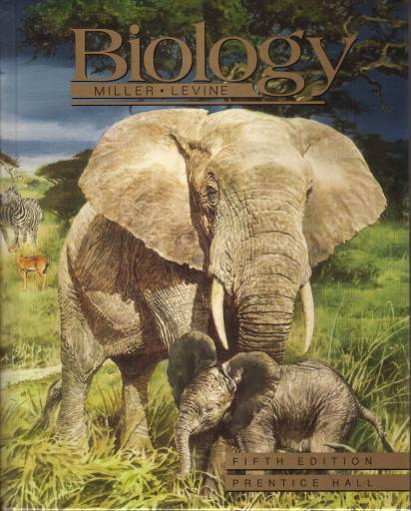
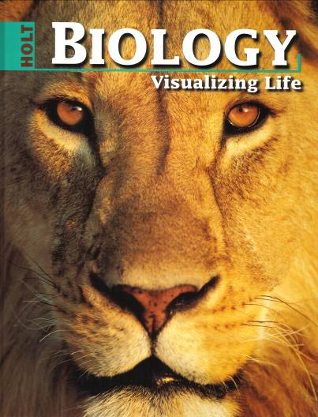
Evolution History of the Life
All species evolved over billions of years from a common ancestor

Slide 4
The Bible and the History of Life
And God made the beast of the earth after his kind, and cattle after their kind, and every thing that creepth upon the earth after his kind: and God saw that it was good.
Genesis 1:25

Slide 5
Evidence
Each model (evolution and creation) can best be determined by examining two lines of evidence
The fossil record (history)
Mechanism for change

Slide 6
The Fossil Record and Education
Biology: Principles and Explorations, Holt, Rinehart, Winston, 2001, p. 283.
"Fossils offer the most direct evidence that evolution takes place….
Fossils, therefore, provide an actual record of Earth's past life-forms. Change over time (evolution) can be seen in the fossil record."
Is this true?

Slide 7
Where Do We Start?
Claims of evolution
Weigh the Facts

Slide 8
Fossil Record
Era | Period | Time (mil)
 | Quarternary | 1.8 – present
 | Teritary | 6.5 – 1.8
 | Cretaceous | 14.5 – 6.5
 | Jurassic | 208 – 14.5
 | Triassic | 245 – 208
 | Permian | 290 – 245
 | Carboniferous | 363 – 290
 | Devonian | 410 – 363
 | Silurian | 440 – 410
 | Ordovician | 505 – 440
 | Cambrian | 544 – 505
 | Precambrian | 650 - 544
Cenozoic
Mesozoic
Paleozoic
The foundation
Cambrian | 544 - 505
Precambrian | 650 - 544

Slide 9
Examining the Evidence
Actual Data
Tree of life
Cambrian
Time
Sudden appearance of complex creatures
Created after their kind
Precambrian
Darwinian Model
Morphology

Slide 10
Cambrian Explosion
David Berlinski (evolutionist), A Tour of the Calculus, 1995
"There is no question that such gaps exist. A big gap appears at the beginning of the Cambrian explosion, over 500 million years ago, when great numbers of new species suddenly appeared in the fossil record."

Slide 11
Cambrian Explosion
Ariel Roth (Ph.D. Zoology), Origins,1998, p. 184.
"The Cambrian explosion is not just a case of all the major animal phyla appearing at about the same place in the geologic column. It is also a situation of no ancestors to suggest how they might have evolved."
Where are the thousands of observable intermediates?

Slide 12
Cambrian Explosion
Biology, Miller and Levine, 2002, p. 746.
"The Cambrian Period, which began 544 million years ago, is marked by an abundance of different fossils. Why the difference from earlier periods?
By the Cambrian period, some animals had evolved shells, skeletons, and other hard body parts…"
Great claims require real evidence

Slide 13
What do the Facts Support?
Precambrian – Cambrian
Invertebrate – Vertebrate
Fish – Amphibian
Horse and Whale
Birds
Created after their kind
Where are the thousands of observable intermediates?

Slide 14
Invertebrate to Vertebrate (Fish)
Biology, Miller and Levine, 2000, p. 680.
"Fishes are considered to be the most primitive living vertebrates…
…similarities in structure and embryological development show that fishes and modern invertebrate chordates probably did evolve from common invertebrate ancestors that lived many millions of years ago."
There is not one single intermediate in the textbook to support this claim!

Slide 15
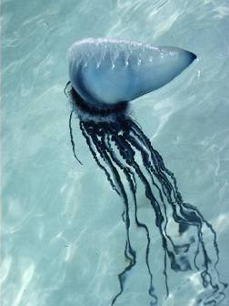
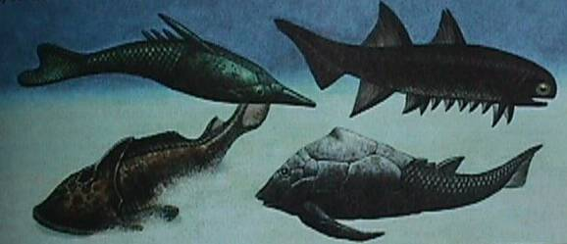
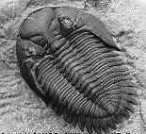
Invertebrate to Vertebrate (Fish)
?
Early fish according to the Biology textbook
Miller and Levine
Invertebrate
(jellyfish)
?
Where are the thousands of observable intermediates?
Trilobite
Notes:
A theme: A theory demands evidence not just stories and rumors.

Slide 16
What do the Facts Support?
Aerial Roth (Ph.D. Zoology), Origins, p. 189.
"However, we have virtually no evidence in the fossil record or elsewhere for any of the changes proposed during this 'immensity of time'; but the public hears nothing of this problem."

Slide 17
What do the Facts Support?
Precambrian – Cambrian
Invertebrate – Vertebrate
Fish – Amphibian
Horse and Whale
Birds
Created after their kind
Created after their kind
Where are the millions of observable intermediates?

Slide 18
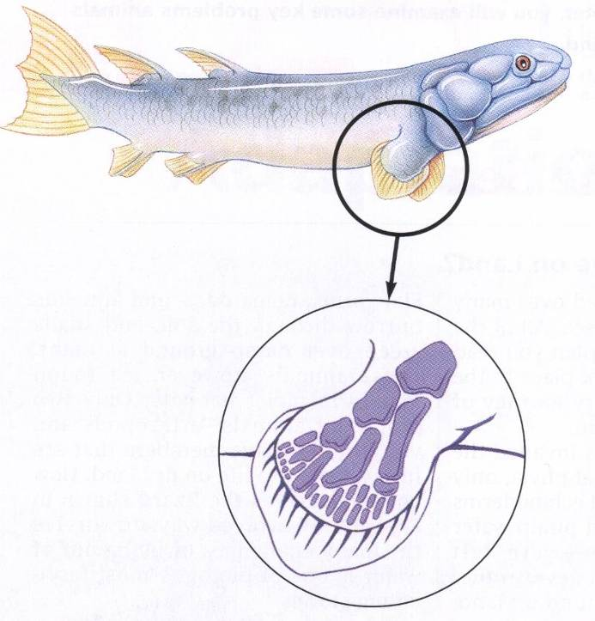
Fish to Amphibian
Biology: Visualizing Life, Holt, Rinehart, and Winston, 1998, p. 461.
"Because of these similarities, scientists think the first amphibians were descendants of the lobe-finned fishes, a group whose modern members include the coelacanth and the lungfishes."
This is supposedly evolving into legs
Notes:
The idea here is that these lobes turned into legs for walking on land.
Why does the author say "scientists think?" because they don't have the evidence

Slide 19
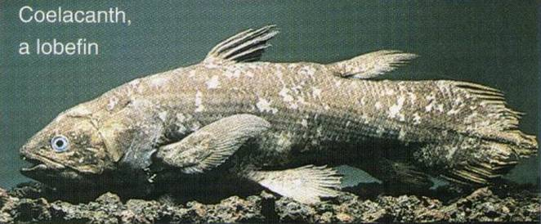
Coelacanth
Extinct for 70 million years
1938 living coelacanths were found
It is still 100% fish
The front fins (lobes) are still fins

Slide 20
What do the Facts Support?
Precambrian – Cambrian
Invertebrate – Vertebrate
Fish – Amphibian
Horse and Whale
Birds
Created after their kind
Created after their kind
Created after their kind
Where are the thousands of observable intermediates?

Slide 21
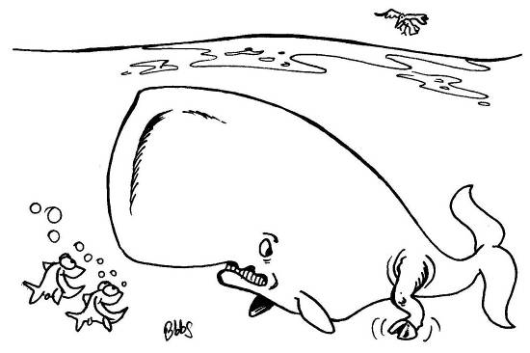
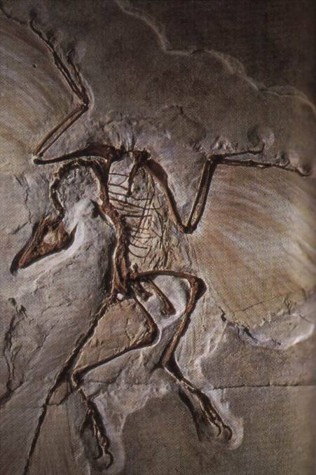
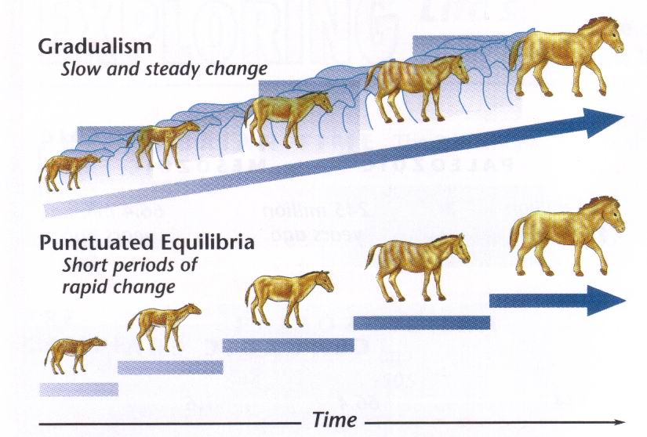
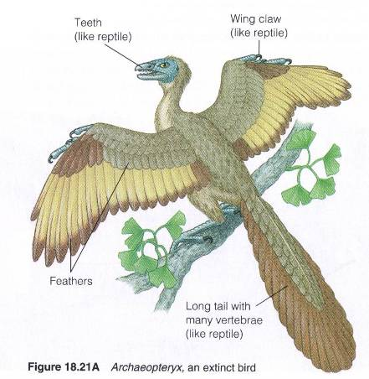
Alleged Intermediates
Horse
Archaeopteryx
Whales
Life Sciences, Prentice Hall, 2002, p. 164.

Slide 22
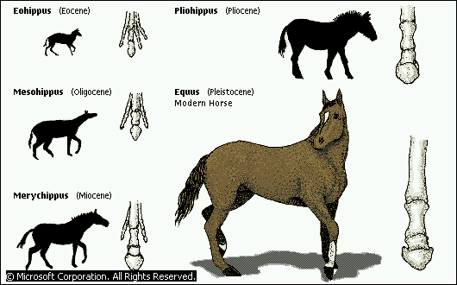
The Horse
"The horse is a well-documented case study in evolution. The fossil record shows clear steps in the progression from a four-toed, small browsing animal - one of a line that gave rise to tapirs, rhinoceroses, and other mammals in addition to horses - to the modern horse,…"
"Evolutionary History of the Modern Horse," Microsoft® Encarta® Encyclopedia 2000. © 1993-1999 Microsoft Corporation.

Slide 23
Evolution and the Horse
Jonathan Sarfati (Ph.D. Physical Chemistry), Creation Ex Nihilo, 1999
"As the biologist Heribert-Nilsson said, 'The family tree of the horse is beautiful and continuous only in the textbooks', and the famous paleontologist Niles Eldredge called the textbook picture 'lamentable' and 'a classical case of paleontologic museology'."
Why would someone make this statement?

Slide 24
What Textbooks Don't Contain
Scientists find "fossil horses" mixed throughout all the different time layers.
The first animal in the series, Eohippus is so different from the modern horse and so different from the next one in the series that there is a big question concerning its right to a place in the series.

Slide 25
What Textbooks Don't Contain
The rib count, vertebrae count, tooth count and the size of the animal, varies widely and does not show any direct line of progression (18, 15, 19, 18)
The Picture
1. Notice the line drawings
2. Similarity could be genetic variability

Slide 26
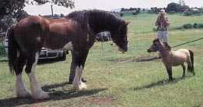
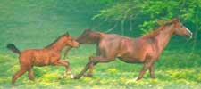
What Textbooks Don't Contain
Many different varieties of horses exist today
The extinct Eohippus was almost identical in body design, feet, toes and size, to the modern living Hyrax, except for the skull and tail (a case of genetic variability)
Notes:
The smallest horse on record, a Falabella miniature pony, stood 19 in, or just under 5 hands, and weighed 30 lb. The largest horse on record was a Belgian that stood 6 ft tall, or 18 hands, and weighed 3,200 lb.

Slide 27
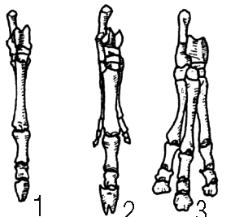
What Textbooks Don't Contain
North America
3-toed to 1-toe
South America
1-toe to 3-toed

Slide 28
What do the Facts Support?
Precambrian – Cambrian
Invertebrate – Vertebrate
Fish – Amphibian
Horse and Whale
Birds
Created after their kind
Created after their kind
Created after their kind
Created after their kind
Where are the thousands of observable intermediates?

Slide 29
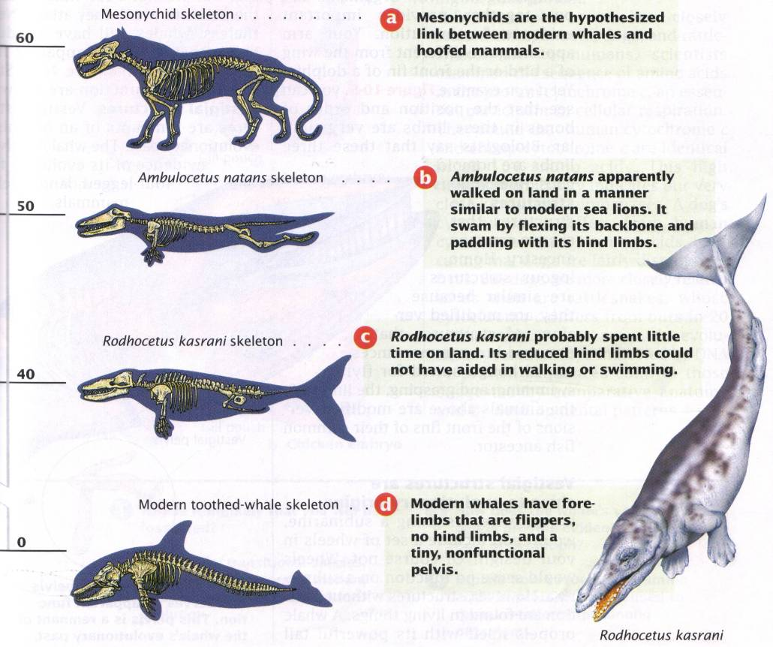
Whale Evolution: A Study of Deception
"For instance, modern whales are the descendants of four-legged land animals that are also the ancestors of horses and cows. As you can see in Figure 10-4, fossil intermediates between modern whales and their 60-million-year-old ancestor reveal a history of slow transformation."
Biology: Visualizing Life, Holt, Rinehart and Winston, 1998, p. 177.
Notes:
These pictures are drawn by an artist. It is not what was found.

Slide 30
Whales: Unique Features
Enormous lung capacity with efficient oxygen exchange for long dives
Powerful tail with large horizontal flukes
Eyes designed to see underwater and withstand high pressure
Ears designed to pick up airborne sound waves and eardrum to withstand high pressure
Skin lacking hair and sweat glands, but incorporate fatty blubber

Slide 31
Whale fins and tongues have counter-current heat exchangers to minimize heat loss
Nostrils on top of the head (blowholes)
Breastfeed under water
Sonar capacity
Critical Thinking
Is there any observable evidence of these changes or is it all based on artists drawings?

Slide 32
Genetics Disproves Whale Evolution
Nicholas Comninellis, M. D., Creative Defense: Evidence Against Evolution, 2001, p. 172.
"Insufficient time exists for such whale evolution to have occurred. Genetics calculations demonstrate that animals with 20 years between each generation could transmit to their offspring no more than about 1,700 mutations during a 10-million year period.
continued

Slide 33
However, almost all mutations are harmful to animals. … Even if these 1,700 mutations were helpful, the new genetic code needed for a land animal to 'become' a whale would be millions upon millions of beneficial mutations."
Where are the thousands of intermediate fossils?
Great claims require real evidence

Slide 34
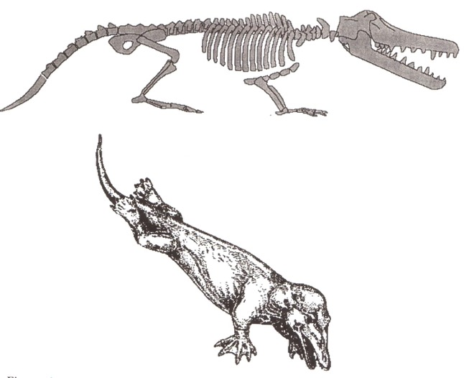
Deception
Kenneth Miller, Finding Darwin's God,1999, p. 265.
Ambulocetus skeleton, as drawn in Miller's book
Ambulocetus reconstruction, as drawn in Miller's book
Actual bones found (shaded portion)
Notes:
Note no pelvic girdle was found. This hinders interpretations of locomotion.

Slide 35
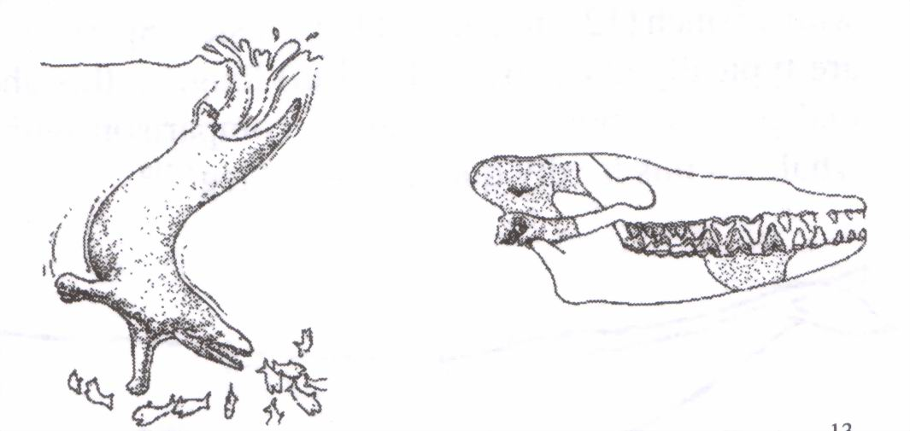
Deception
Pakicetus: another candidate for whale evolution
Artist reconstruction
Only the shaded portions of the skull were found

Slide 36
Did Whales Have Legs?
Some modern whales have a pair of bones embedded in their tissues
Are these left over legs?
No

Slide 37
Whales Do NOT Have Legs
They have a known function and differ in males and females
They are not attached to the vertebral column
They are used to strengthen the pelvic wall and act as an organ anchor for reproduction

Slide 38
Another Claim
In 1956, a Sperm Whale was found with a 5-inch tibia projecting into a 5 ½ inch bump
Was this a leg?
Sperm whales are large - up to 62 feet long
A 5 ½ inch bump on its side would look like a pimple
People are sometimes born with abnormalities such as an extra finger, or an extra rib

Slide 39
Where is the Evidence?
The changes required in the evolutionary belief system for a land animal to become a whale are incredibly complex and far reaching

Slide 40
Land Mammals to Whales
Develop a new mode of locomotion (from walking to swimming)
A physiology to cope with a dense medium (water rather than air)
New methods of detecting and catching prey
A means of breathing efficiently at the sea surface
Every part of the body has to change

Slide 41
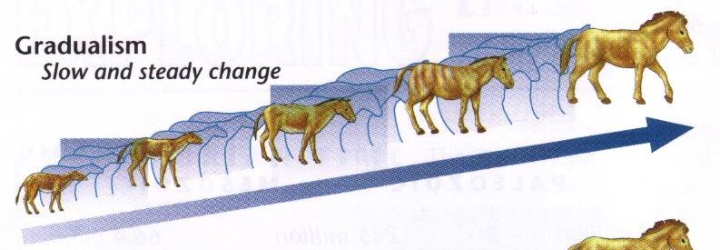
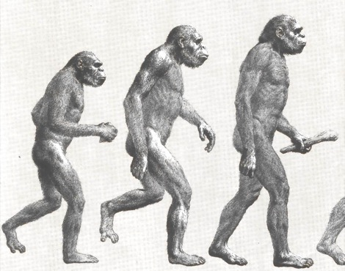
Why Evolutionists Believe
X
Notes:
Evolutionists want to believe in evolution so bad they will resort to deceiving their followers and anybody else they can control in the education system, including professors, teachers, and students by making up data that does not exist.

Slide 42
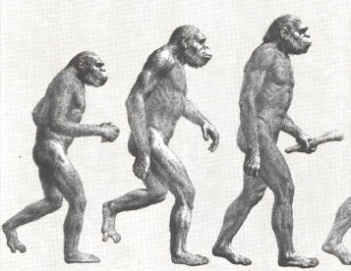
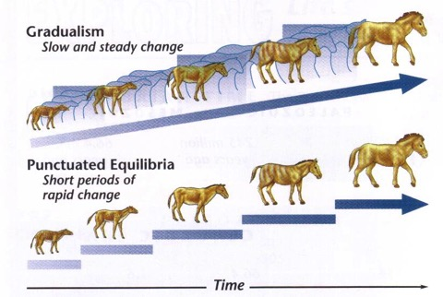
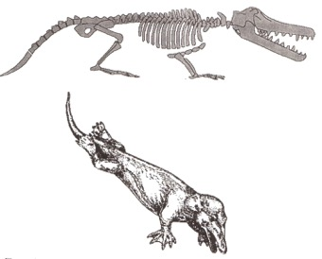
Deception
Evolutionists want to believe in evolution so bad they will resort to deceiving their followers and anybody else they can control in the education system, including professors, teachers, and students by making up data that does not exist.

Slide 43
What do the Facts Support?
Precambrian – Cambrian
Invertebrate – Vertebrate
Fish – Amphibian
The Horse and Whales
Birds
Created after their kind
Created after their kind
Created after their kind
Created after their kind
Where are the thousands of observable intermediates?

Slide 44
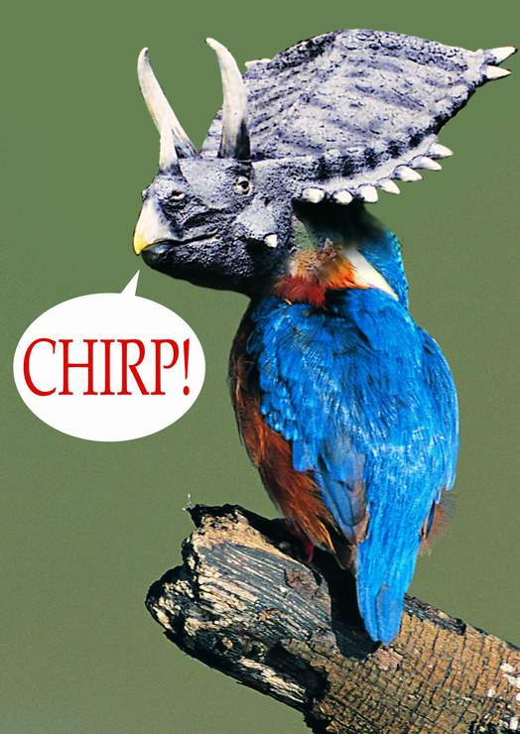
The Amazing Tricerakeet!

Slide 45
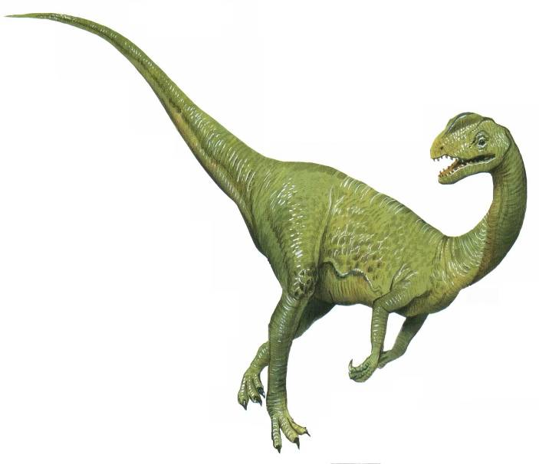
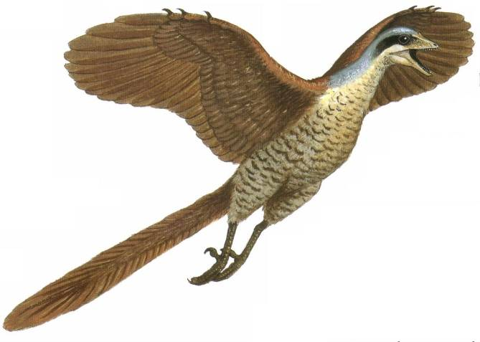
Education and Textbooks
Biology, Miller and Levine, 2002, p. 907.
"To many paleontologists a bird is a dinosaur with feathers. That definition may sound odd, but it makes sense."

Slide 46
Education and Textbooks
Biology: Principles and Explorations, Holt, Rinehart, Winston, 2001, p. 268.
"Birds evolved from reptiles during the Jurassic period."

Slide 47
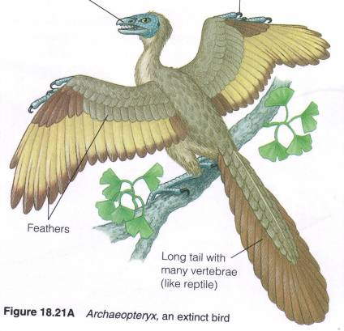
Archaeopteryx
Biology: Concepts and Connections, Campbell, Mitchell, and Reece, 2000, p. 390.
"Like modern birds, it had flight feathers, but otherwise it was more like some small bipedal dinosaurs of its era; for instance, like those dinosaurs, Archaeopteryx had teeth, wing claws, and a tail with many vertebrae."

Slide 48
What Textbooks Don't Include
James Perloff, Tornado in a Junkyard, 1999, p. 18.
"As for its 'reptile' characteristics, yes, it had claws on its wings, but so does the ostrich, and nobody considers it part reptile.
True, Archaeopteryx had teeth, but so did other fossil birds, and its teeth differed distinctly from those of reptiles…
As to Archaeopteryx's tail, further inspection has shown it strongly resembles a swan's."

Slide 49
Birds Are Different From Reptiles
Stuart Burgess (Ph.D. Engineering Design, Professor of Combustion Theory, extensive study in the area of design in nature), Hallmarks of Design,2002, p. 47.
"Birds are so different from other creatures that there would have been hundreds of thousands of intermediate forms between birds and land animals if birds had evolved."

Slide 50
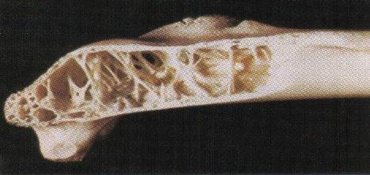
Reptile to Bird
Development of feathers
Reform of respiratory system
Reform of skeletal system – hollow bones
Reform of digestive system
Reform of nervous system
Construction of bills & beaks
Mastery of nest building
Acquisition of flight
Development of sound producing organ
Notes:
In Eichstátt, Germany, in 1984 there was a major meeting of scientists who specialize in bird evolution, the International Archaeopteryx Conference. They disagreed on just about anything that was covered there on this creature, but there was very broad agreement on the belief that Archaeopteryx was a true bird. Only a tiny minority thought that it was actually one of the small, lightly built coelurosaurian dinosaurs [small lightly framed dinosaurs].

Slide 51
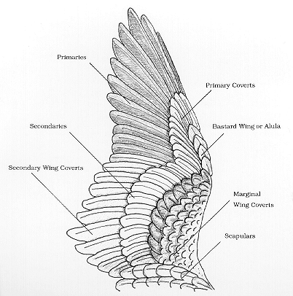
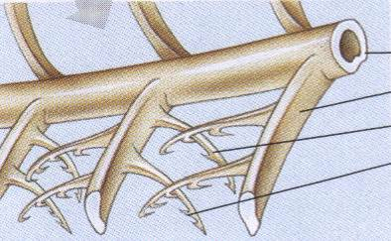
The Feather
Primary Feathers
Secondary Feathers
Hook
Barbule
Barb
Shaft
Notes:
Feathers have a basic form of a central hollow supporting shaft called a 'rachis' and a number of fine side branches. These side branches have even finer sub-branches in contour feathers. The side branches in these are called barbs and are linked together by a set of barbules and their hooklets sometimes called 'Hamuli'. Barbs have side branches of their own called barbules. The upper ones containing a series of hooklets and the lower ones without hooks but slightly convex in form to catch the hooklets of the barbules from the next barb along the shaft.
Secondaries - the major lifting feathers, between the primaries and the body, attached to the ulna.

Slide 52
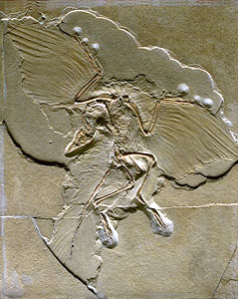
Archaeopteryx
Alan Feduccia (World authority on birds), Science, "Archaeopteryx: Early Bird Catches a Can of Worms", 1993
"Paleontologists have tried to turn Archaeopteryx into an earth-bound, feathered dinosaur. But it's not. It is a bird, a perching bird. And no amount of 'paleobabble' is going to change that."

Slide 53
Birds Are Different From Reptiles
Alan Feduccia, (professor and former chair of biology at UNC), The Origin and Evolution of Birds, Yale University Press, 1999, p. 81.
"This creates a new problem for those who insist that dinosaurs were ancestors of modern birds. How can a bird hand, for example, with digits two, three and four evolve from a dinosaur hand that has only digits one, two and three? That would be almost impossible."

Slide 54
Birds Are Different From Reptiles
Dr. Alan Feduccia, "Scientist Says Ostrich Study Confirms Bird 'Hands' Unlike Those Of Dinosaurs", EurekAlert, 14-Aug-2002.
"If one views a chicken skeleton and a dinosaur skeleton through binoculars they appear similar, but close and detailed examination reveals many differences. Theropod dinosaurs, for example, had curved, serrated teeth, but the earliest birds had straight, unserrated peg-like teeth. They also had a different method of tooth implantation and replacement."

Slide 55
Archaeopteryx
David Menton (Ph.D. Cellular Biology) and Carl Wieland (M.D.), "Bird Evolution Flies Out the Window," Creation Ex Nihilo, 1994.
"And like other birds, both Archaeopteryx's maxilla (upper jaw) and mandible (lower jaw) moved, while in most reptiles, only the mandible moves. Archaeopteryx's brain had a large cerebellum and visual cortex – the same as that found in today's flying birds."

Slide 56
Reptile to Bird
Stuart Burgess (Ph.D. Engineering Design, Professor of Combustion Theory, extensive study in the area of design in nature), Hallmarks of Design,2002, p. 47.
"It is often speculated that birds evolved from reptiles. However, there are enormous conceptual differences between the two classes of creature…"

Slide 57
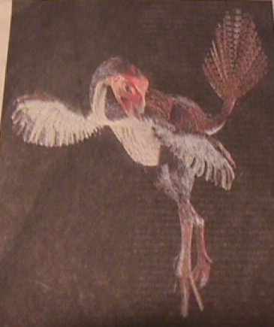
Dinosaur to Bird Evolution
Is there any real evidence that dinosaurs evolved into birds?
National Geographic Society and the feathered dinosaur "Archaeoraptor" October 15, 1999
The story exposed

Slide 58
Bird Fraud
"Red-faced and downhearted, paleontologists are growing convinced that they have been snookered by a bit of fossil fakery from China. The 'feathered dinosaur' specimen that they recently unveiled to much fanfare apparently combines the tail of a dinosaur with the body of a bird."
R. Monastersky, "All mixed up over birds and dinosaurs," Science News, January 15, 2000

Slide 59
More Bird Mistakes
1993 – Mononkykus the "flightless bird" (cover of Time magazine)
Not a bird but a theropod
1996 – "Feathered Fossil Proves Some Dinosaurs Evolved into Birds" (Science) Sinosauropteryx prima
The feathers turned out to be a array of fibers
1998 – China Protoarchaeopteryx robusta

Slide 60
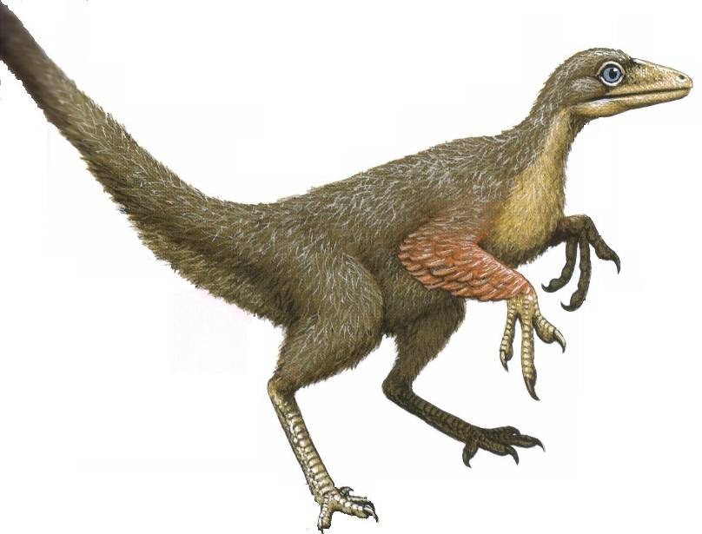
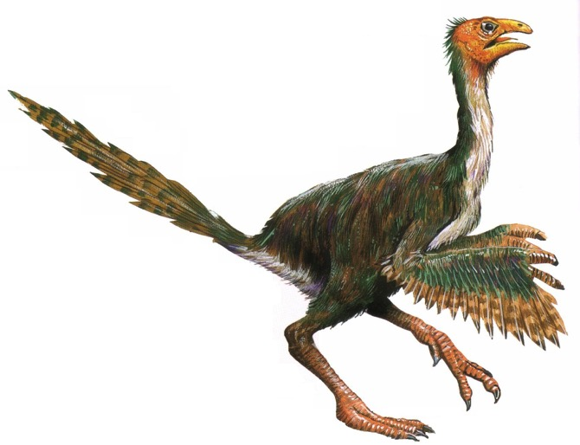
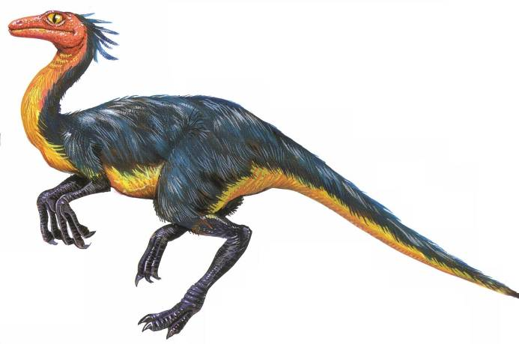
Feathered Deceptions
Encyclopedia of Dinosaurs, 2002
X
Microraptor
Sinornithosaurus
Caudopteryx
Notes:
None of these creatures were found. They are deceptive and only in the minds of people who believe evolution so much that the real evidence does not matter.

Slide 61
Evidence, Faith & Deception
X
Notes:
Evolutionists want to believe in evolution so bad they will resort to deceiving their followers and anybody else they can control in the education system, including professors, teachers, and students by making up data that does not exist.

Slide 62
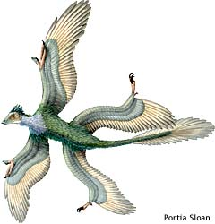
A New Discovery
The find supports the gliding-in-trees model
Microraptor gui
Birds already existed before Microraptor gui
Long feathers on the feet would be a hindrance
What is the source of new information?

Slide 63
Mutations
Maxim D. Frank-Kamenetski, Unraveling DNA, 1997, p. 72.
(Professor at Brown U. Center for Advanced Biotechnology and Biomedical Engineering)
"Mutations are rare phenomena, and a simultaneous change of even two amino acid residues in one protein is totally unlikely. …
One could think, for instance, that by constantly changing amino acids one by one, it will eventually be possible to change the entire sequence substantially…
continued

Slide 64
These minor changes, however, are bound to eventually result in a situation in which the enzyme has ceased to perform its previous function but has not yet begun its 'new duties'. It is at this point it will be destroyed – along with the organism carrying it."

Slide 65
Summary: Fossil Record
Ernst Mayr (Professor Emeritus in the Museum of Comparative Zoology at Harvard University, Hailed as the Darwin of the 20th century), What Evolution Is, 2001, p. 14.
"Given the fact of evolution, one would expect the fossils to document a gradual steady change from ancestral forms to the descendants. But this is not what the paleontologists finds. Instead, he or she finds gaps in just about every phyletic series."
Evolution is a matter of faith

Slide 66
What do the Facts Support?
Precambrian – Cambrian
Invertebrate – Vertebrate
Fish – Amphibian
Horse and Whales
Birds
Created after their kind
Created after their kind
Created after their kind
Created after their kind
Created after their kind
Where are the thousands of observable intermediates?

Slide 67
Mechanism for Change
Single cell Invertebrate
Invertebrate Vertebrate (fish)
Fish Amphibian
Amphibian reptile
Reptile Bird/mammal
Ape-like creature Human
What was the mechanism that could cause all this to happen?

Slide 68
Natural Selection
Genetic Variation
Ability to adapt to the environment
Survival of the fittest
Can natural selection cause one kind (species) to become a new kind?
No
Can only select from existing information
Can cause a loss of information
Has no foresight into the future

Slide 69
Natural Selection and Mutations
If evolution is true
Mutations and disorders
Natural selection should eliminate harmful disorders
Time

Slide 70
Natural Selection and Mutations
12000
10000
8000
6000
4000
2000
0
Mendelian Inheritance in Man
encyclopedia of human genes and disorders
MIM Entries
Observed data
1965 1970 1975 1980 1985 1990 1995 1999

Slide 71
Mutation
Detrimental
Neutral
Beneficial
Disease
No change
Add information
No
Yes
No evolution
No evolution
Change morphology
yes
No
Evolution possible
No evolution

Slide 72
Mutations
Insertions
Deletions
Inversions
Duplications
Translocations
Recombination's
Most are harmful or neutral
Programmed gene expressions
Bacteria resistance to antibiotics

Slide 73
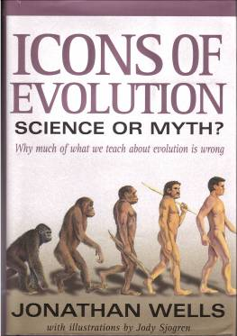
Mutations and Evolution
Jonathan Wells, Ph.D. Molecular Biology
"But there is no evidence that DNA mutations can provide the sorts of variation needed for evolution…
There is no evidence for beneficial mutations at the level of macroevolution, but there is also no evidence at the level of what is commonly regarded as microevolution."

Slide 74
Mutations
Lee Spetner (Ph.D. Physics – MIT, taught information and communications at Johns Hopkins University), Not By Chance, 1997, pp. 131, 138
"But in all the reading I've done in the life-sciences literature, I've never found a mutation that added information…
All point mutations that have been studied on the molecular level turn out to reduce the genetic information and not increase it."

Slide 75
Johnjoe McFadden (Professor of Molecular Biology and Quantum Physics), Quantum Evolution, 2000, p. 71.
"… most species, including most horses, appear abruptly in the fossil record, change very little over their entire history and then disappear just as unceremoniously. This pattern is well known to paleontologists who have actually attributed it to the imperfection of the fossil record: the missing links between one species and another have all died without the decency to leave their remains as fossils."

Slide 76
Conclusion
Based on the evolution model, the entire foundation for Darwinian evolution (mechanism for change and the fossil record) is missing.
Why should I accept the fossil record for support of evolution when you cannot produce the evidence?
I already have a faith. Tell me about your faith and I will tell you about my faith.
Notes:
There is no physical evidence to support evolution in the fossil record
Note: don't let them go to other alleged intermediates until they can build a foundation. No foundation and the model crumbles. They have to accept it by faith.

Slide 77
Logical Deduction
It is rational (reasonable) to believe that God, not unknown events, created all life forms after their kind

Slide 78
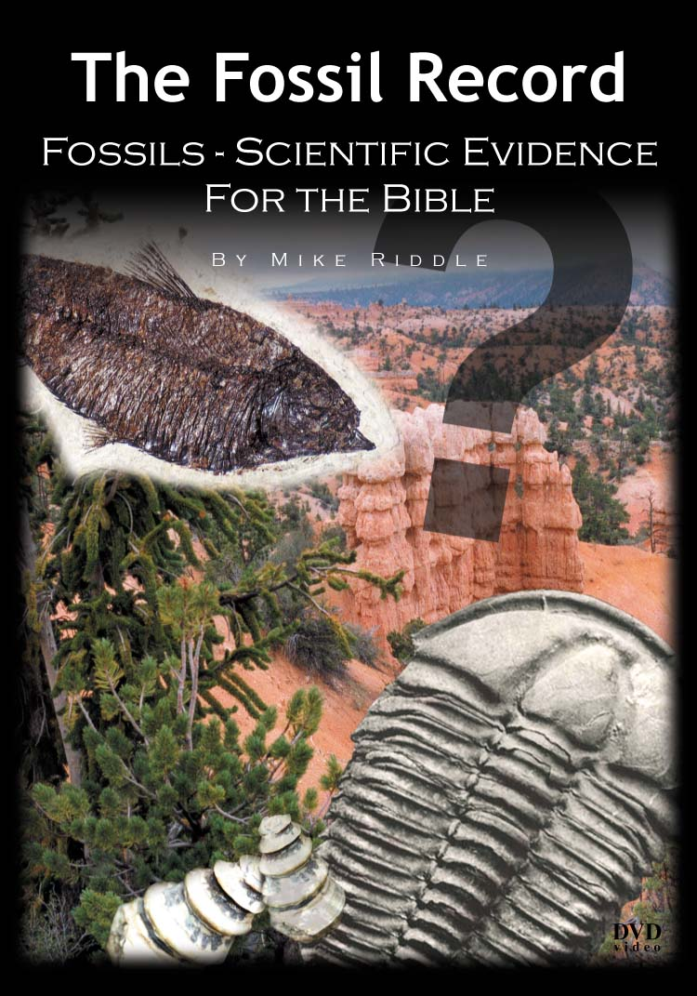
The Lecture on DVD
Plus Free
Lesson plans
Objectives
Detailed outline of the DVD
Exercises
Answer Keys
www.Train2Equip.com

Slide 79
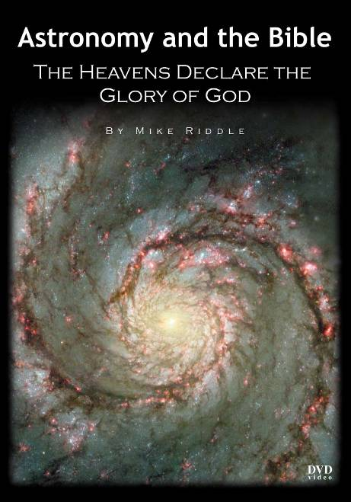
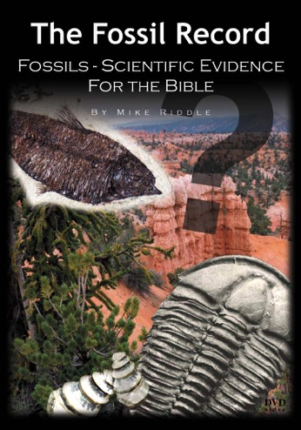
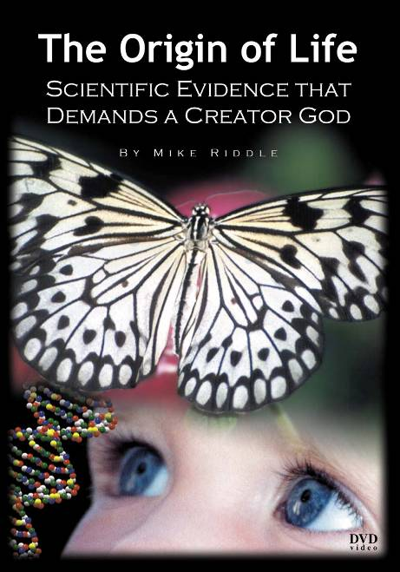
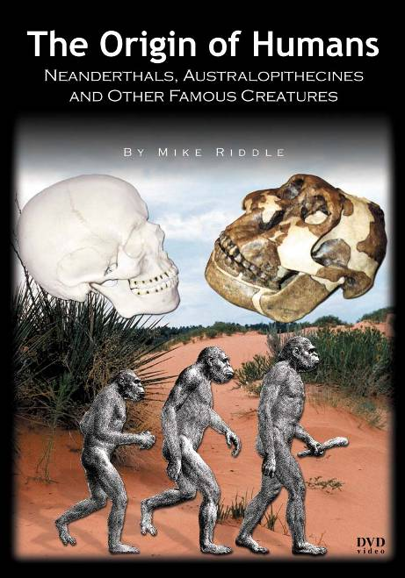
Set of 6 DVDs for $96

Slide 80
The Origin of Life
Equipping Course

Slide 81
Coming in August 2004
On-Line, web-based creation training program
www.Train2Equip.com

Slide 82
The Fossil Record
Mike Riddle
Institute for Creation Research
www.icr.org
Mike@Train2Equip.com

Slide 83
Black

Slide 84
Creation link at BibleStudyDownloads.org
Get this presentation for free!
Notes:
OT Survey (os)

